Slide 2
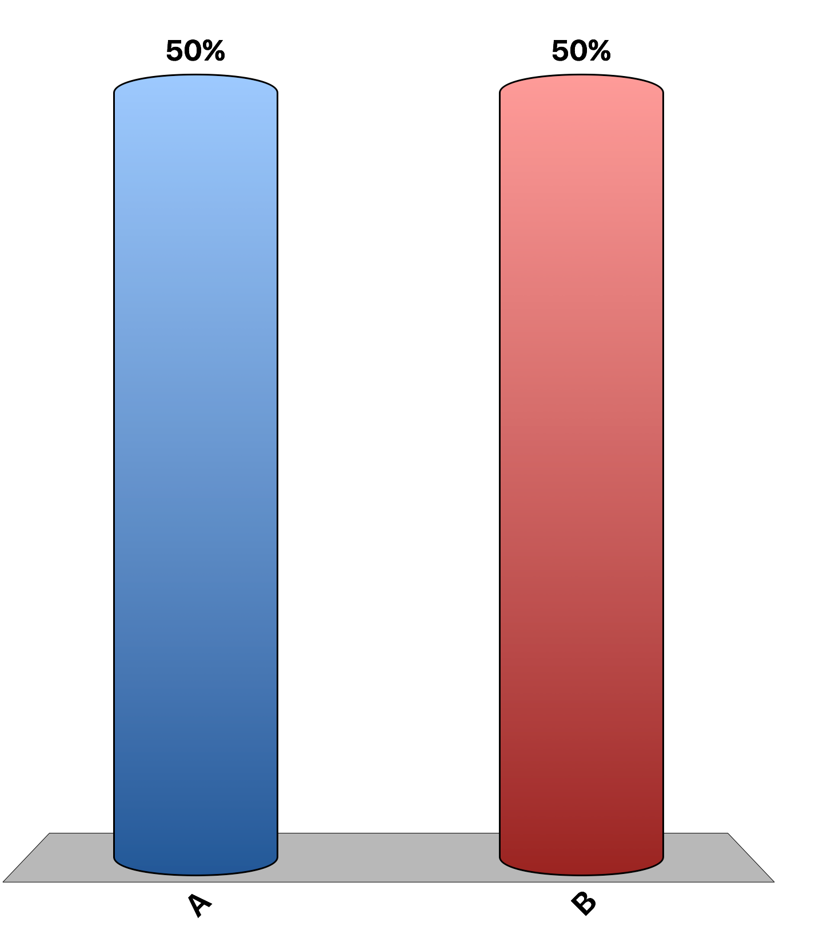
Sunk costs are irrelevant for decisions in the short run.
True
False

Slide 3
The supply curve of the competitive firm is its average total cost curve above marginal cost.
True
False

Slide 4
A competitive firm will exit the industry if profits are not greater than zero in the short run.
True
False

Slide 5
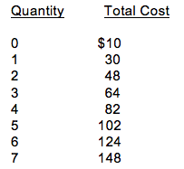
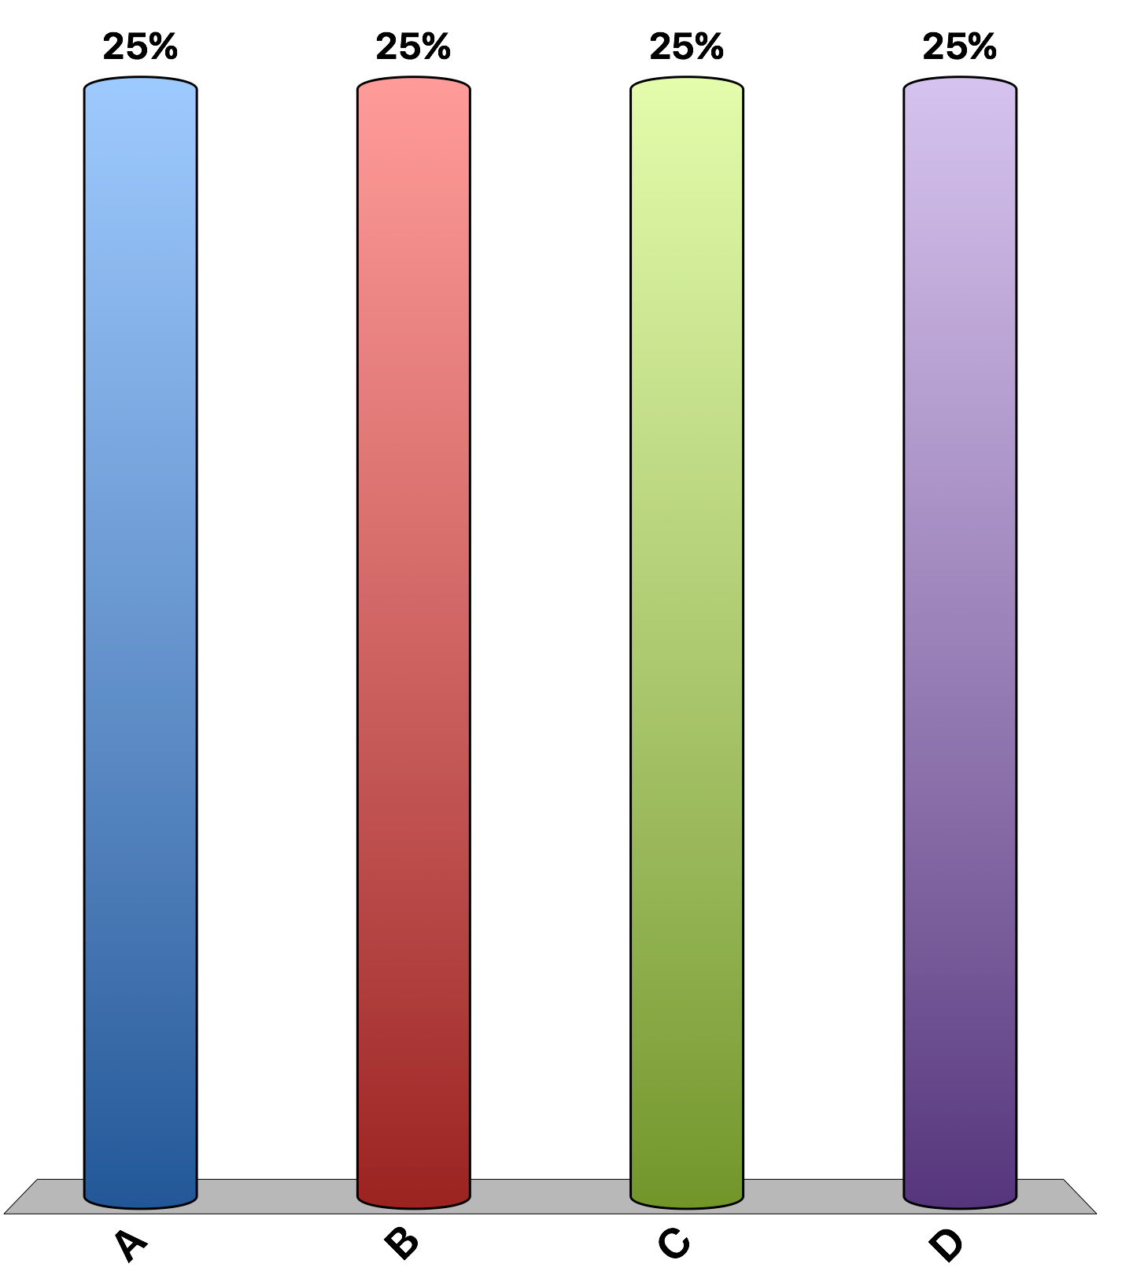
Refer to the table. What is the marginal cost of producing the 4th unit of output?
$10
$18
$20
$82

Slide 6
A competitive firm will charge a price:
determined by its average total cost
determined by its marginal cost
determined on the market, by the market demand and market supply
determined on the market, by the average total cost and marginal cost

Slide 7
For a perfectly competitive firm, the relationship between price (P), marginal revenue (MR), and average revenue (AR) is as follows:
P = AR, and P > MR
P = MR, and MR > AR
AR = MR, and P > AR
P = AR = MR

Slide 8
The textile industry is composed of a large number of small firms. In recent years, many textile firms have suffered economic losses. Economic theory suggests that these conditions will
shift the demand curve to the right so that price will rise to the level of production cost.
cause the remaining firms to collude so that they can charge a higher price.
cause the market supply to decline and the price of textiles to rise.
cause the firms in the textile industry to suffer long-run economic losses.

Slide 9
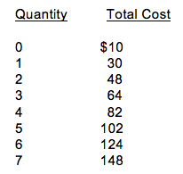
Refer to the table. Assume that the firm can sell any output at the market price of $21. To maximize profit or minimize loss, the firm will produce
3 units.
4 units.
5 units.
6 units.

Slide 10
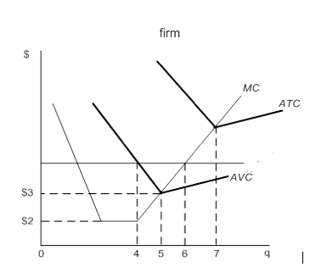
Refer to the figure. If the market price is $2.00, this perfectly competitive firm should:
increase output in the short run to maximize profits.
produce 4 units of output to maximize profits
produce 6 units of output to minimize losses
shut down in the short run to minimizes losses

Slide 11
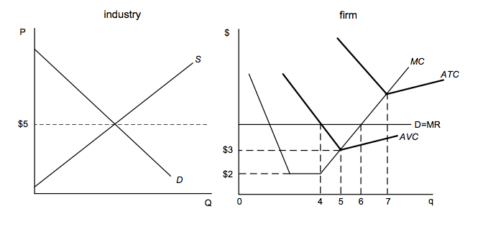
Refer to the figures. For the individual firm in a competitive market, the optimal quantity of output is _____, which would earn _________.
4 units, profits of $2 per unit.
5 units, losses of $2 per unit.
6 units, losses of an unspecified amount.
7 units, profits of $3 per unit.

Slide 12
Suppose that wheat is produced in a perfectly competitive market. If market demand increases, the individual wheat farmer’s marginal revenue will
increase, and her profit-maximizing level of output will increase.
increase, and her profit-maximizing level of output will decrease.
decrease, and her profit-maximizing level of output will increase.
decrease, and her profit-maximizing level of output will decrease.

Slide 13
The Chocolate Moose Ice Cream Store is a business that closes from November to April each year. The best explanation for closing during these months is that the store’s
revenues are insufficient to cover total costs.
total fixed costs are less than marginal fixed cost.
revenue per unit is less than average variable cost.
marginal costs are less than the revenues.

Slide 14
Art’s Garage operates in a perfectly competitive market. Suppose that at the point where marginal cost equals marginal revenue, ATC = $20, and AVC = $15. If the price per unit is $10, in the short run Art will
break even.
shut down immediately.
shut down but only after the lease on the garage expires.
sustain losses in the short run but will continue to operate.

Slide 15
Suppose that a market is in long-run equilibrium. Then demand increases. Suppose that the entry of new firms into the industry causes the price of a scarce resource used by firms in the industry to increase. The long-run supply curve for this industry would likely be
upward sloping.
horizontal.
downward sloping.
U-shaped.

